Slide 1
Subscriber and Viewership Behavior
By Chak Wong

Slide 2
Introduction
1. We have free trials of different lengths. What conclusions can you draw about the success of the various trial lengths? Is there enough information to gauge conversion rate from free trial to paid? If so, is there any bias your estimate?
2. Please flag any abnormal signup activity and use the internet to try and identify any drivers.
3. Is there any seasonality in signup and viewing events?
4. Can you draw any insights into viewing behavior?
5. Further Analysis and Next Steps

Slide 3
1. Success Rate of Free Trials
From the complete number of possible users (n = 1320482), 74671 users were considered as successful conversions [because they contained complete data from both datasets]. There was a 5.65% conversion rate.
From the successful conversions, ~54% (n = 40301) were from 7-day trials and ~46% (n = 34335) were from 30-day trials.
However, there's not enough information to gauge an unbiased conversion rate from free trial to paid simply to due the large portion of missing data. I attempted to partition whether the view event came before the trial period (vice versa) by looking at the dates, but it wasn't a completely viable solution.

Slide 4
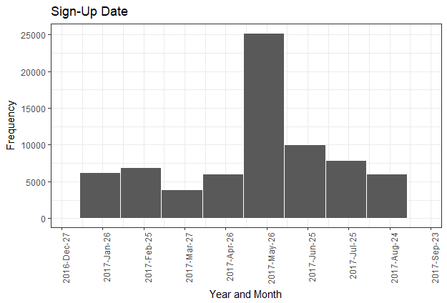
2. Signup Activity and Possible Drivers
On average, there’s ~ 5000 sign ups per month, though signups increased 5-fold in the month of May, and then a sharp then gradual decrease back to the normal monthly signup of 5000 subscribers.
Internet research suggests that Amazon Prime [during and before May, 2017] introduced two interesting features that may have caused the spike in subscribers:
CBS-All Access Showtime without ads
Amazon Prime Channel now functions as a TV channel.
These two products could have most likely precipitated increased viewership.

Slide 5
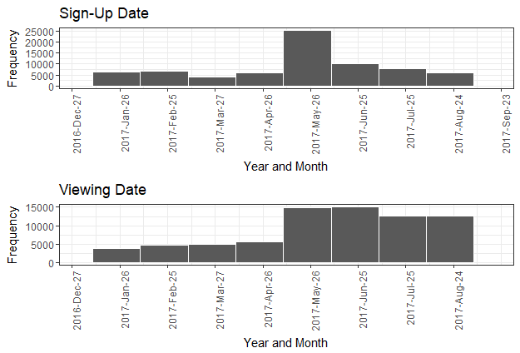
3. Is there any seasonality in signup and viewing events?
Sign-up and viewing plots indicate an interesting trend:
Before May 2017, both were at ~5,000 subscribers
During and after May 2017, there was a huge spike of subscribers, though more people signed up than viewed
* Only completed data was used

Slide 6
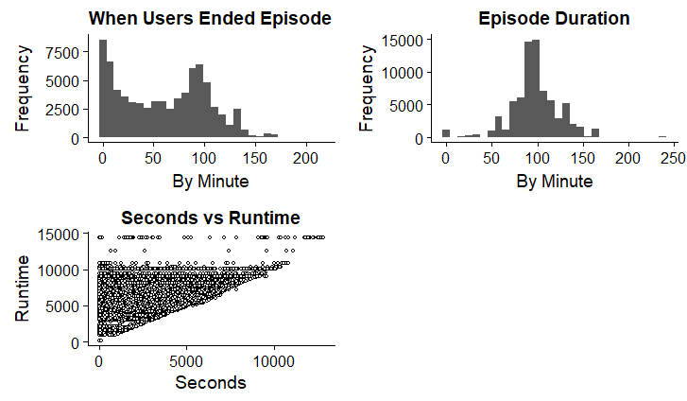
4. Viewing Behavior Insights
The average view of each title is about 60 minutes, regardless of how long each episode. The distribution of runtime is normally distributed, which makes sense, while the actual viewing of each episode is positively skewed, indicating that most people stop watching the episode before it ends.
A scatterplot was visualized to explore possible relationship between when the subscriber stopped watching the title and the title's length. Results indicate a positive correlation (r = 0.413) between the two variables, though it should be cautioned that runtime is always greater than when the episode stopped, as previously suggested.

Slide 7
5. Further Analysis and Next Steps
Obtain historical data dating back 2 years to see viewing behavior across months and different years, derive average coefficients to create time series models
Obtain missing data of when users signed up. If there’s viewing data, then there’s sign up data.
Visualize cross-sectional viewing and sign-up behavior across different months and years (stacked histograms)
Obtain data of user behavior whenever they’re using CBS or Amazon Prime to ascertain a full understanding of viewer behavior of the product to make better predicts
Understand what drives sign-up rate and what causes it.
Understand what causes viewers to be susceptible to making future purchases of products (ads)

Slide 8
Thank You for the Interview

